Slide 1

Case Study Presentation
Interview : Sr. Revenue Science Analyst
Presented by: Umashankar Lath
November 11th, 2022

Slide 2

Introduction
MS in Data Science from University of Illinois, graduating in December, 2022
Experienced Data science professional ~2.5 years of experience
Background – Logistics, Optimization

Slide 3
Case Summary
Aggarwal Automobiles - Fuel Station in India since 1981
Three products - Petrol, Diesel, HSP
Average Daily sales of ₹ 0.52 Million
High Competition - During FY 2015–16, average overall consumption of petrol and diesel grew by 11 %, number of fuel stations increased by 2500
Challenges – High Inventory Level and Rising Competition

Slide 4
SWOT Analysis
Strengths
Weaknesses
Opportunities
Threats
Strengths: Legacy, Technological Capabilities
Weaknesses: Maintaining high inventory levels, Lack of Strategic approach
Opportunities: Rising market demand, Overall sector growth
Threats: Increase in competitors, Low Customer satisfaction

Slide 5
Strategic Framework – 3C’s Analysis
Customers
Competition
External Factors impacting business
Current Business Processes
Cost Analysis
Company
Customer Segmentation and Profile
Product Diversification e.g., EV Stations, Convenience stores
Customer Retention strategy
Barriers to entry
Current market position
Competitor Analysis, e.g., Geographical concentration, Acquisition opportunity

Slide 6
Inventory Management Strategy
Push Strategy (Current)
Just in Time strategy (Proposed)
Maintaining high inventory levels based on historical demand
High operating costs
Manager Intuition influencing the inventory orders
Easy to maintain positive customer satisfaction
Managing Inventory based on a dynamic demand planning
Low overhead expenses
Driven by dynamic forecasting
High risk of understocking and thus risk of unsatisfied customers

Slide 7
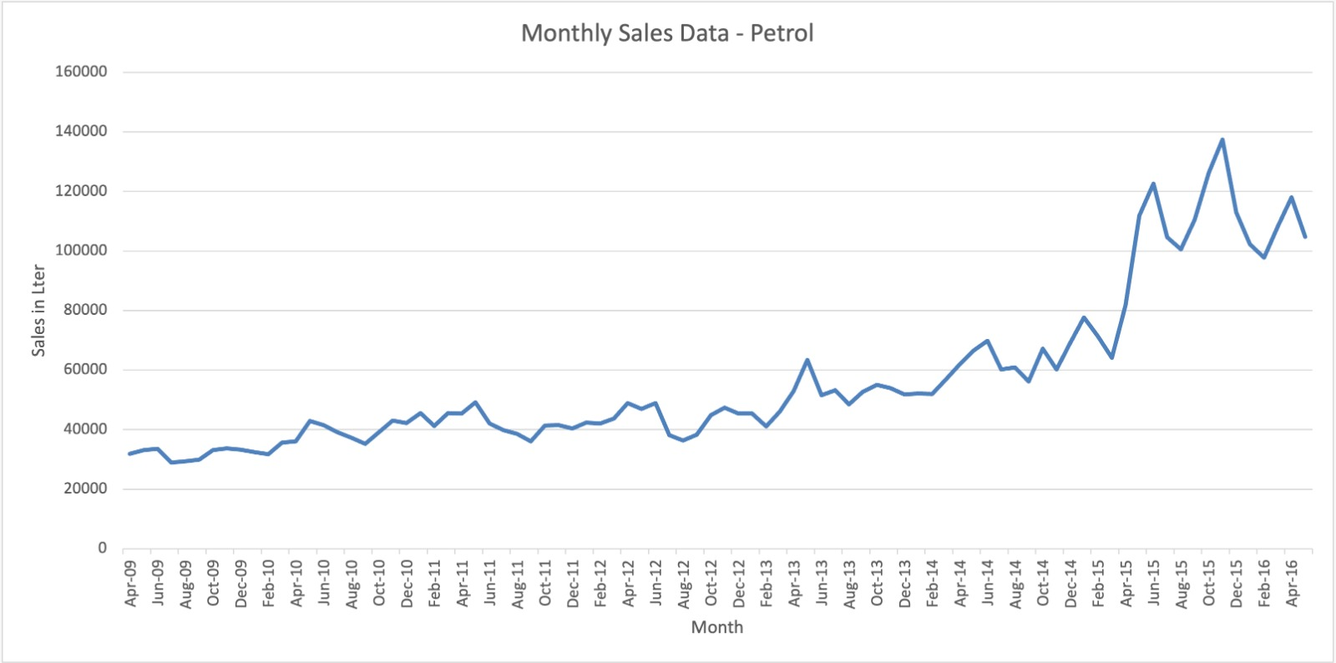
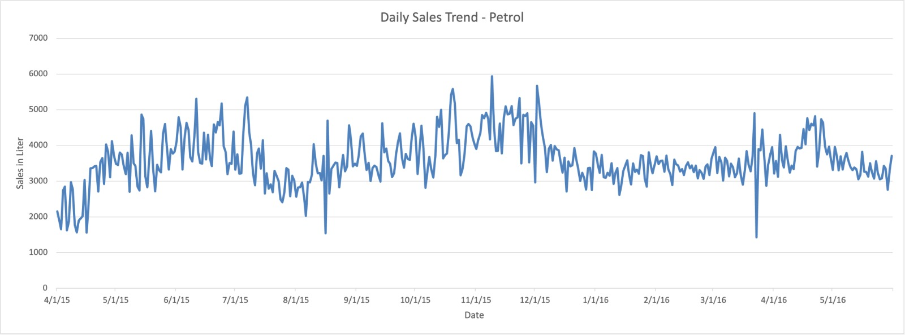
Trend Analysis

Slide 8
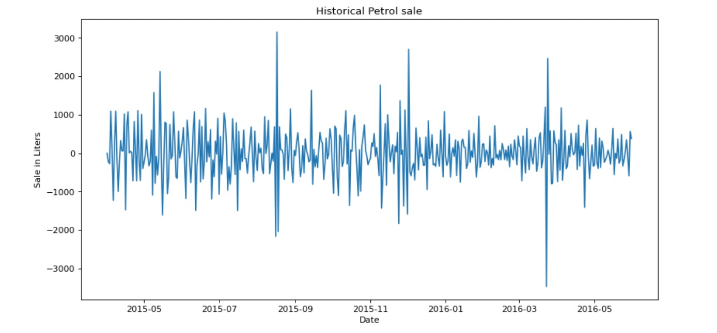
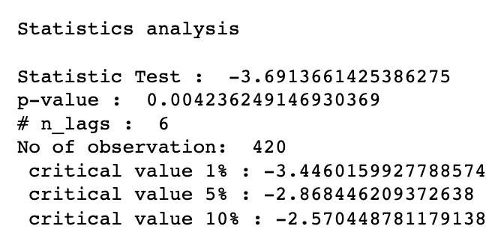
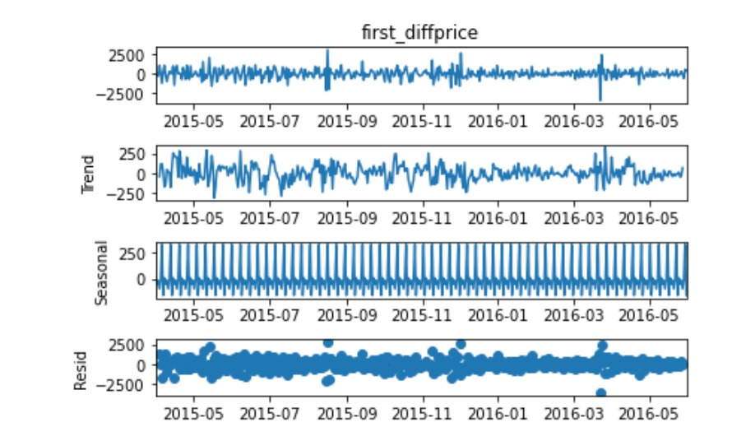
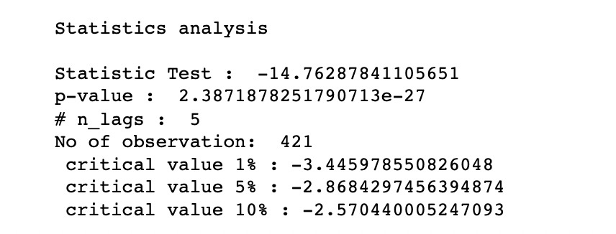
Data Processing
1. ADF Fuller Test
2. Seasonal Decomposition
3. First differencing

Slide 9
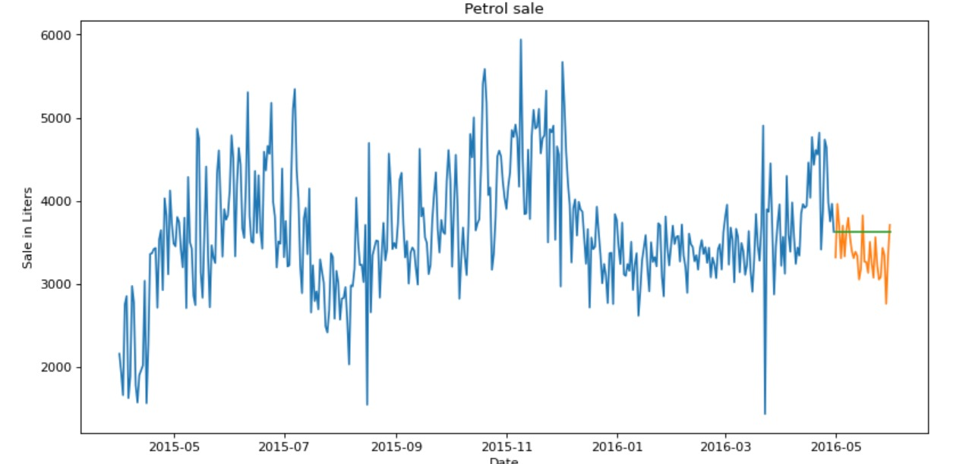
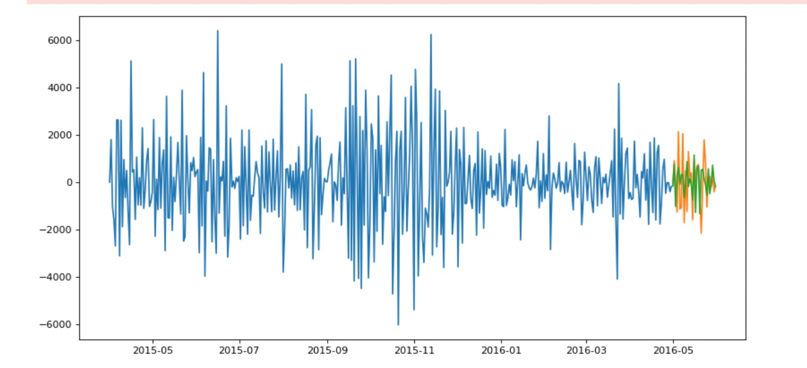
Time Series Forecasting
Constant Value Model
Model | Product | RMSE | MAPE
Constant Value | Petrol | 360.4 | 9.55
 | Diesel | 1114.5 | 22.87
AR | Petrol | 606.9 | 16.8
 | Diesel | 400 | 9
MA | Petrol | 670.6 | 19.25
 | Diesel | 1058.3 | 21.11
ARIMA | Petrol | 426.01 | 11.6
 | Diesel | 300 | 6.27
ARIMA Model

Slide 10
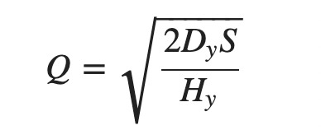
Inventory Model – EOQ
Safety Stock Calculation
Current at least 40% of the tank capacity
i.e. 20,000 *0.4 = 8000 liters
Calculating safety stock for petrol based on ARIMA –
Mean = 3623
SD= 726
Assuming Normal distribution, for 99% confidence level
Z= 2.3
Safety stock = Z* Mean
= 2.3 *3623
= 5300
Reduction in Inventory = 33%
Calculating EOQ for petrol May, 2016
Here, D= Monthly Demand, 110220 from ARIMA model
S= Ordering Cost per order, Rs 150
H= Holding Cost per order per year, Rs 70 *0.1=0.7
Substituting the value of the variables,
Q= 2700 Liters (Approx.)

Slide 11
Recommendation
Implement daily and monthly sales forecasting using ARIMA Model
Maintain minimum inventory level according to dynamic sales forecasting, instead of rule-based model
Use EOQ Model to find optimal ordering quantity

Slide 12
Thank You

